Slide 1
The snails
A DECO3801 Presentation
By Michael Delmastro (45360714), Harry Guthrie (44342870), Joshua Hwang (44302650), Richard Marron (45306721), Leodegario Orpilla III (45295517), and Christopher Stanfield Flores (45328095)

Slide 2


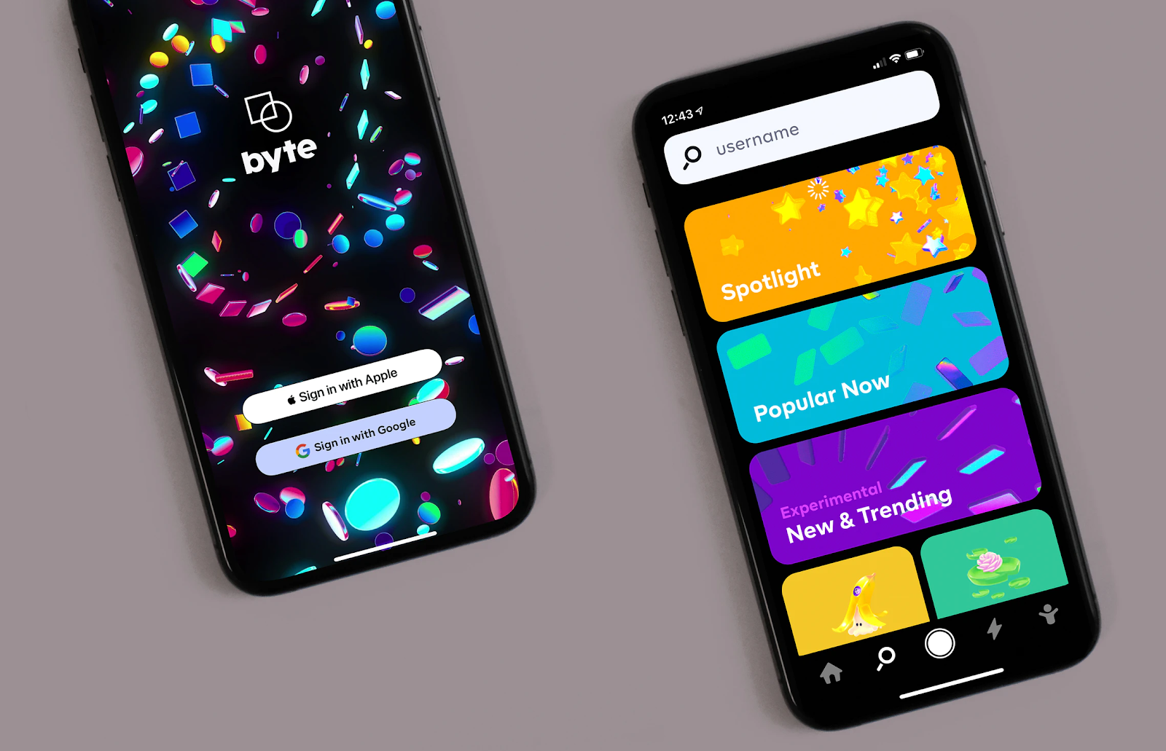
Introduction
Whether you are a new student at the University of Queensland or a student who wants to keep up to date with the latest news, our team the Snails have you covered. We are currently in the process of building an application to enhance your experience at UQ.

Slide 3
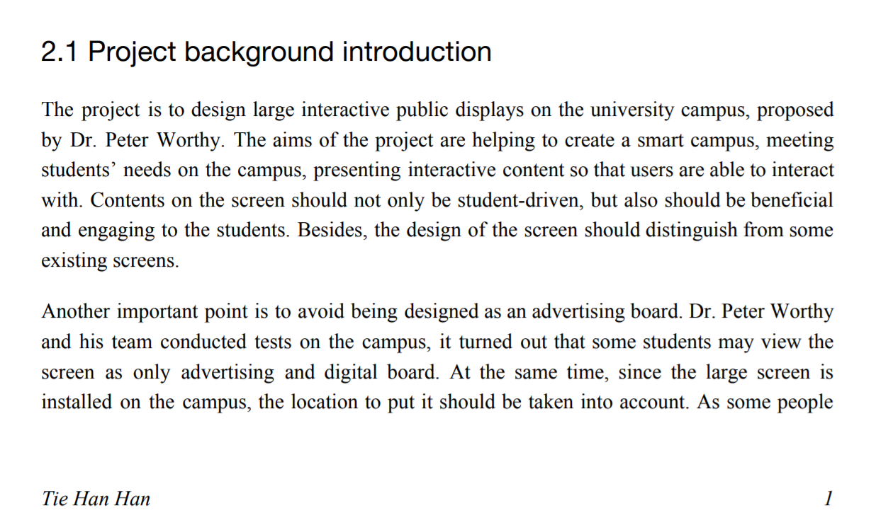
Design brief

Slide 4
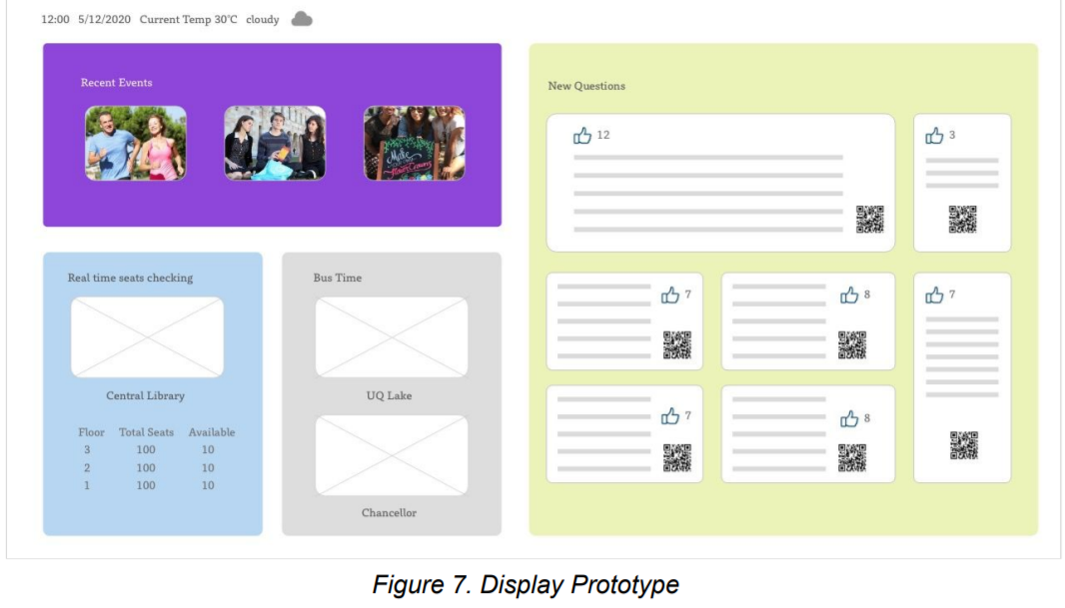
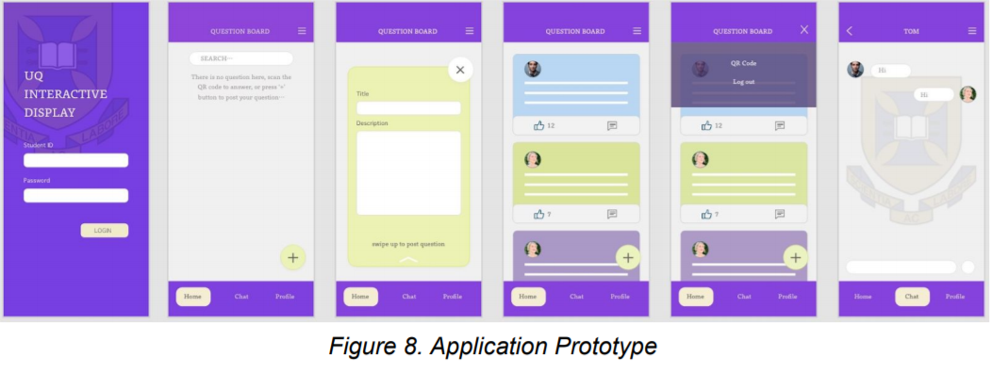
Ideation of Solution:
Original Design Specification

Slide 5
Feature List:
Campus Q&A - asked questions.
Campus Help/FAQ - Displays answers to frequently asked questions.
Campus Map - The user will also have an ability to cast or project this data (limited to navigation) to the displays.
Events Calendar - Displays current and upcoming events by UQ, UQ Union and UQ Union-affiliated organisations.
Information Bar - A bar displaying useful information such as time, date, weather, humidity and UV index.
Social Connections Between Students- users can chat with other students on an opt-in basis.
Identifying boards through QR codes - QR codes generated and refreshed periodically to avoid replay attacks.

Slide 6
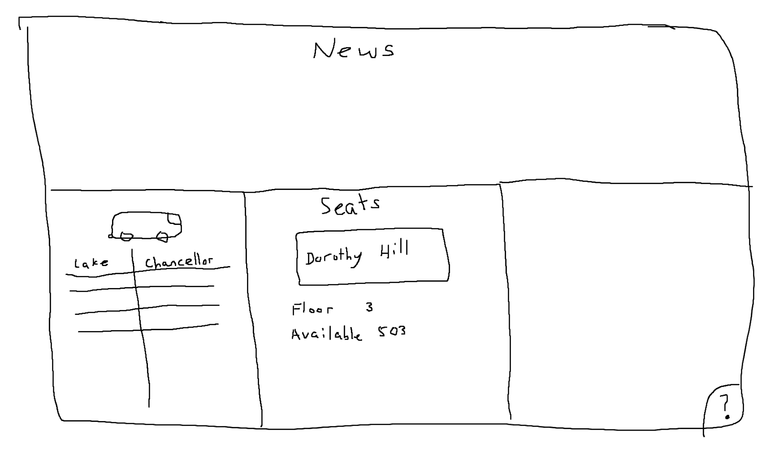
Design process (Information board)

Slide 7
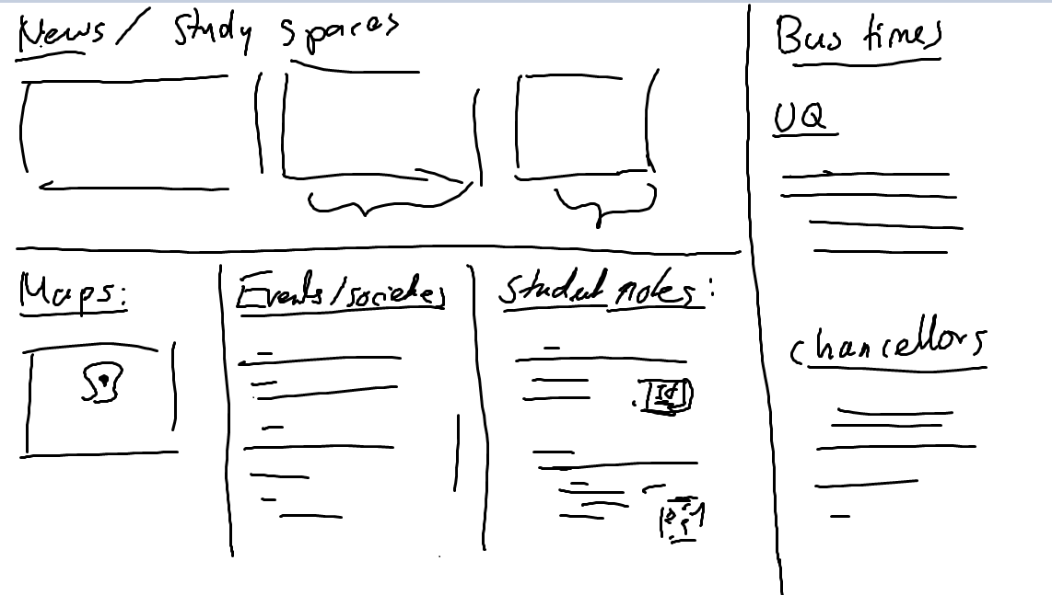
Design process (Information board)

Slide 8

Information board Design process: UQ Colours

Slide 9
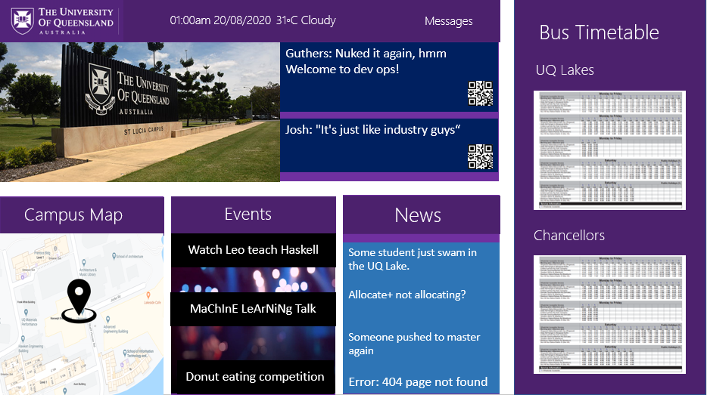
Design layout (UQ Colours)

Slide 10

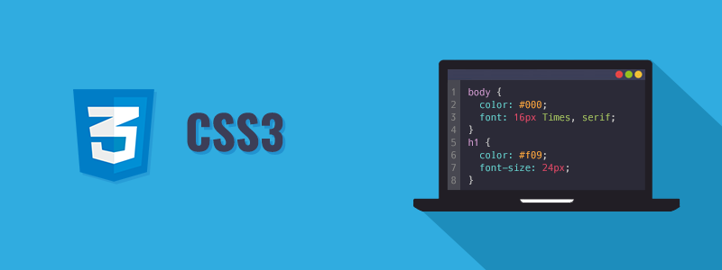

Front-end
Consists of:
WebApp Screen
WebApp Mobile

Slide 11
Justification of Technologies:
Allows us to easily build composable UI. Apps such as Facebook uses it. It is a popular JavaScript library. There are also lots of documentation and guides to help us.
Static typing for JavaScript. It provides a better developer experience

Slide 12
Key Points for Dashboard
It is customizable and configurable for the site admin
This means they can have different layouts for different screens
Key Points for Mobile
We are using the same technologies
Makes it easier for state management
Also using Material UI for prototyping

Slide 13
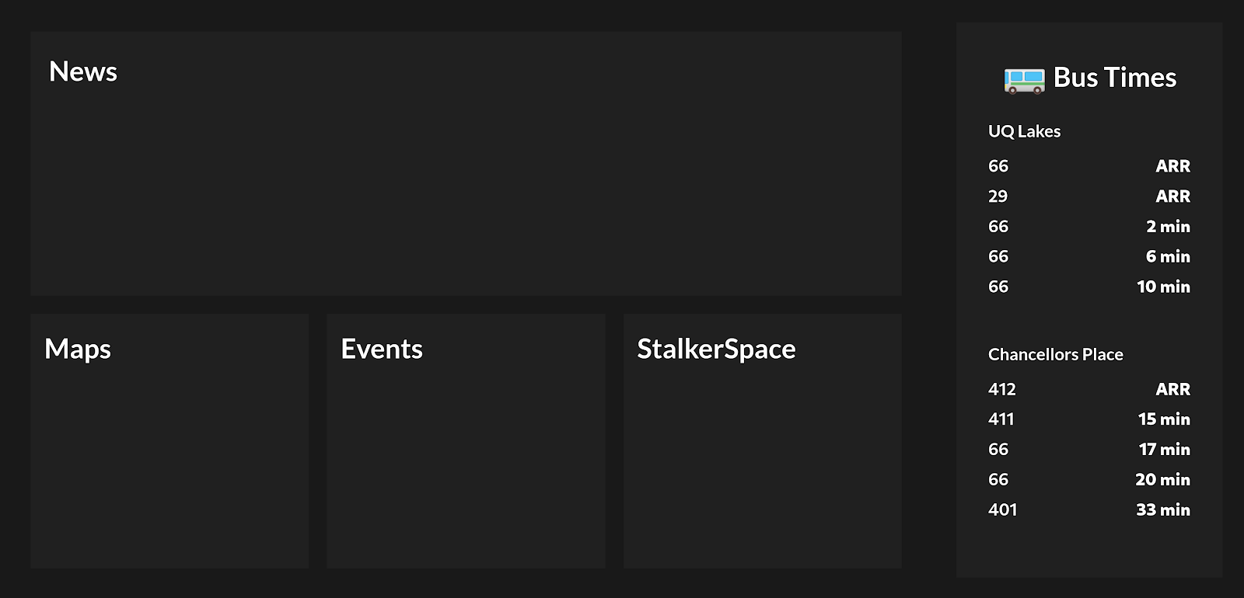
Rough Design programmed(Information board)

Slide 14
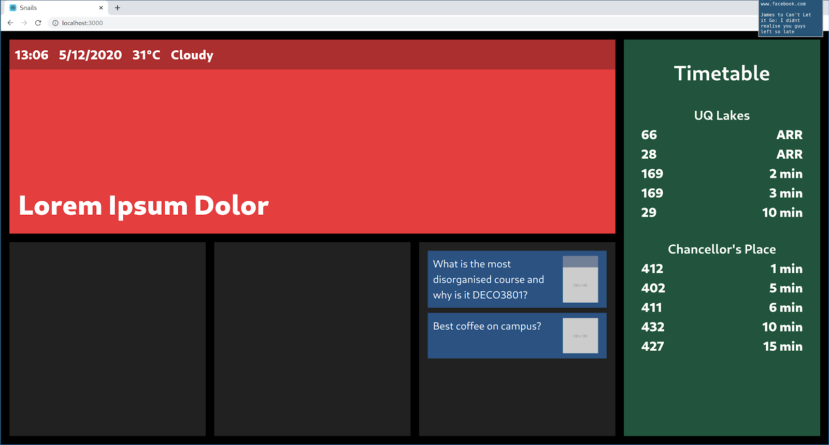
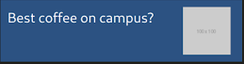
Design process (Information board)

Slide 15
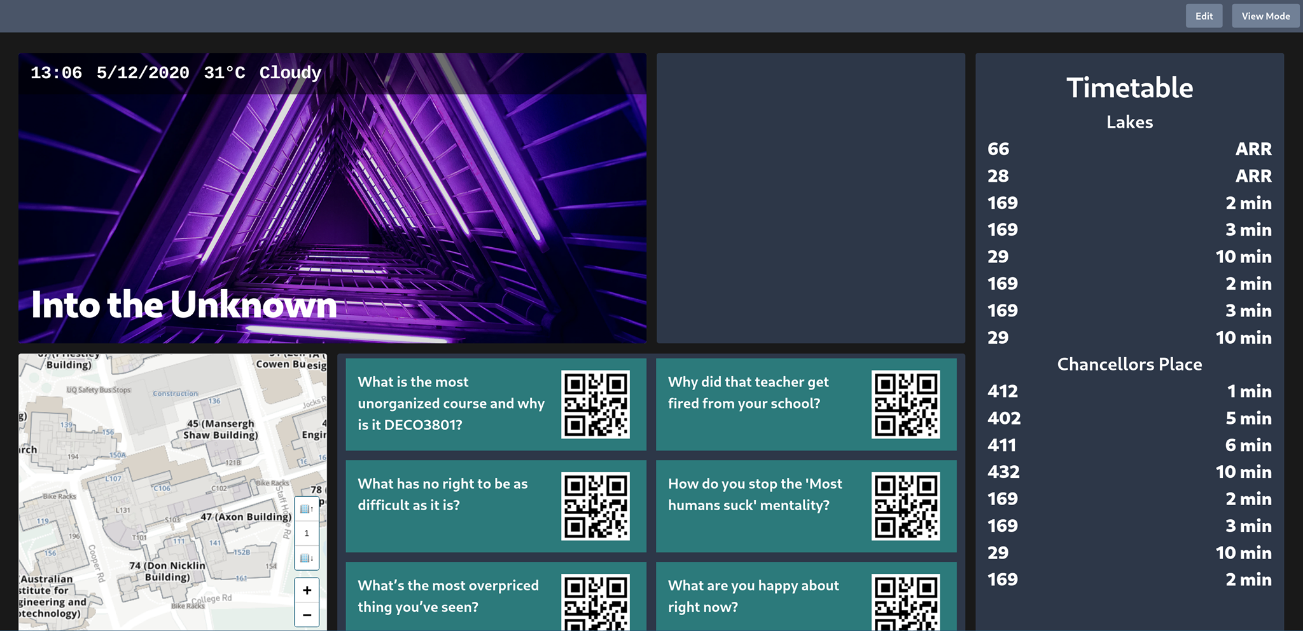

Final Design: information Board

Slide 16
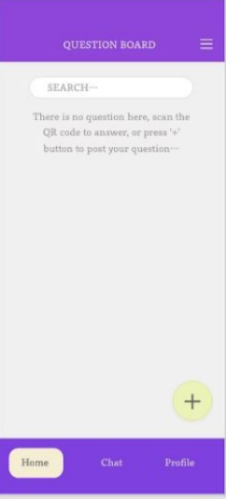

Initial Design based on the specification
Search . . .
Search for a user or a post
Go to the home page (This page)
Message a friend
Add a post

Slide 17
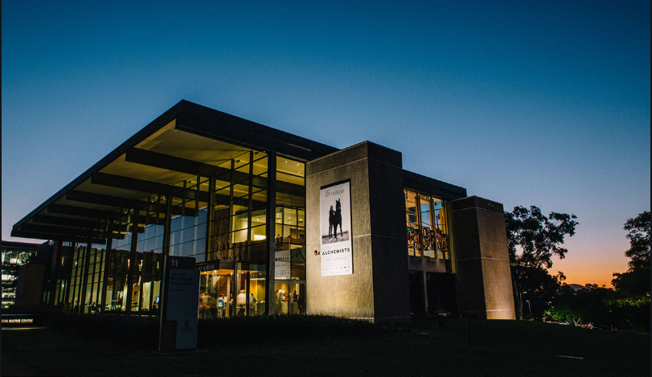

Refined design based on the specification Design
Search . . .
Search for a user or a post
Events
Shows latest posts/news
Scan a QR Code
Message a friend
Add a post

Slide 18
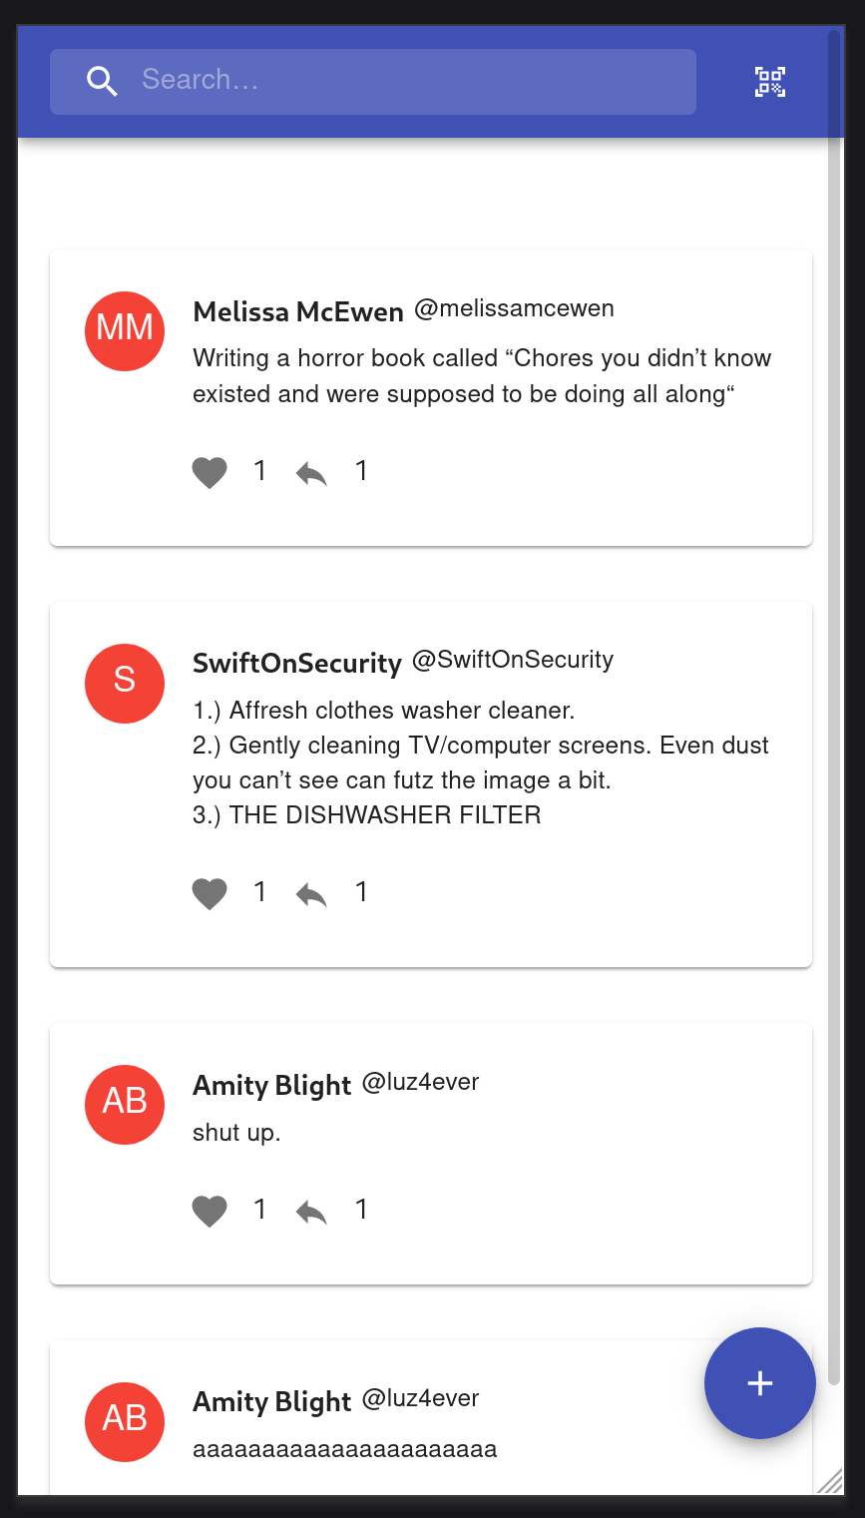
Final Design: Mobile app

Slide 19




Backend
MySQL
Database
Restful API
Python
Docs!
UQAuth
WebApp Screen
WebApp Mobile

Slide 20

DEV OPS
MySQL
Database
UQCloud Webproject
Setbacks
Different environments always pose new problems
Reliability of services
Useful learnings
Always takes longer than expected

Slide 21
Demonstration
https://deco3801-the-snails.uqcloud.net/apidocs

